Slide 1

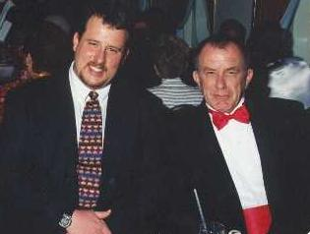
Exposure CS 2021
for CS1
Chapter 18 Section 1-5 Slides
More Graphics:
Mouse Events & Key Events
PowerPoint Presentation
created by:
Mr. John L. M. Schram
and Mr. Leon Schram
Authors of Exposure
Computer Science

Slide 2
Section 18.1
Introduction

Slide 3
The Last Chapter is Special!
In this chapter you will learn more advanced graphics features. These features will not be as advanced as those taught in AP® Computer Science-A or Advanced Graphics, but they still will allow you to create more impressive graphics programs.
There will be no homework exercises for this chapter. There will also be no quizzes and no test. The information covered in this chapter will not even be part of the Final Exam. However, there are 2 lab assignments – 1 minor lab and 1 major lab – that are based on the information in this chapter. At John Paul II High School the major lab counts as the 4th Quarter Project.

Slide 4
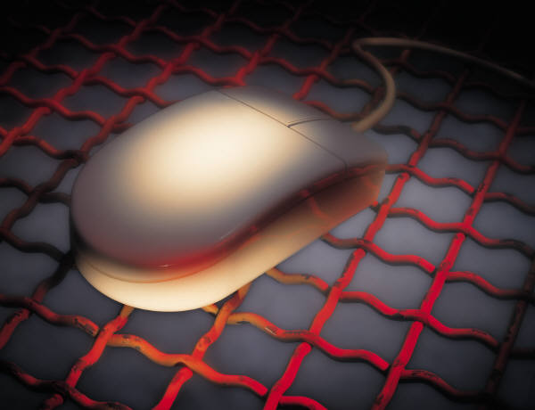
Section 18.2
Mouse Events

Slide 5
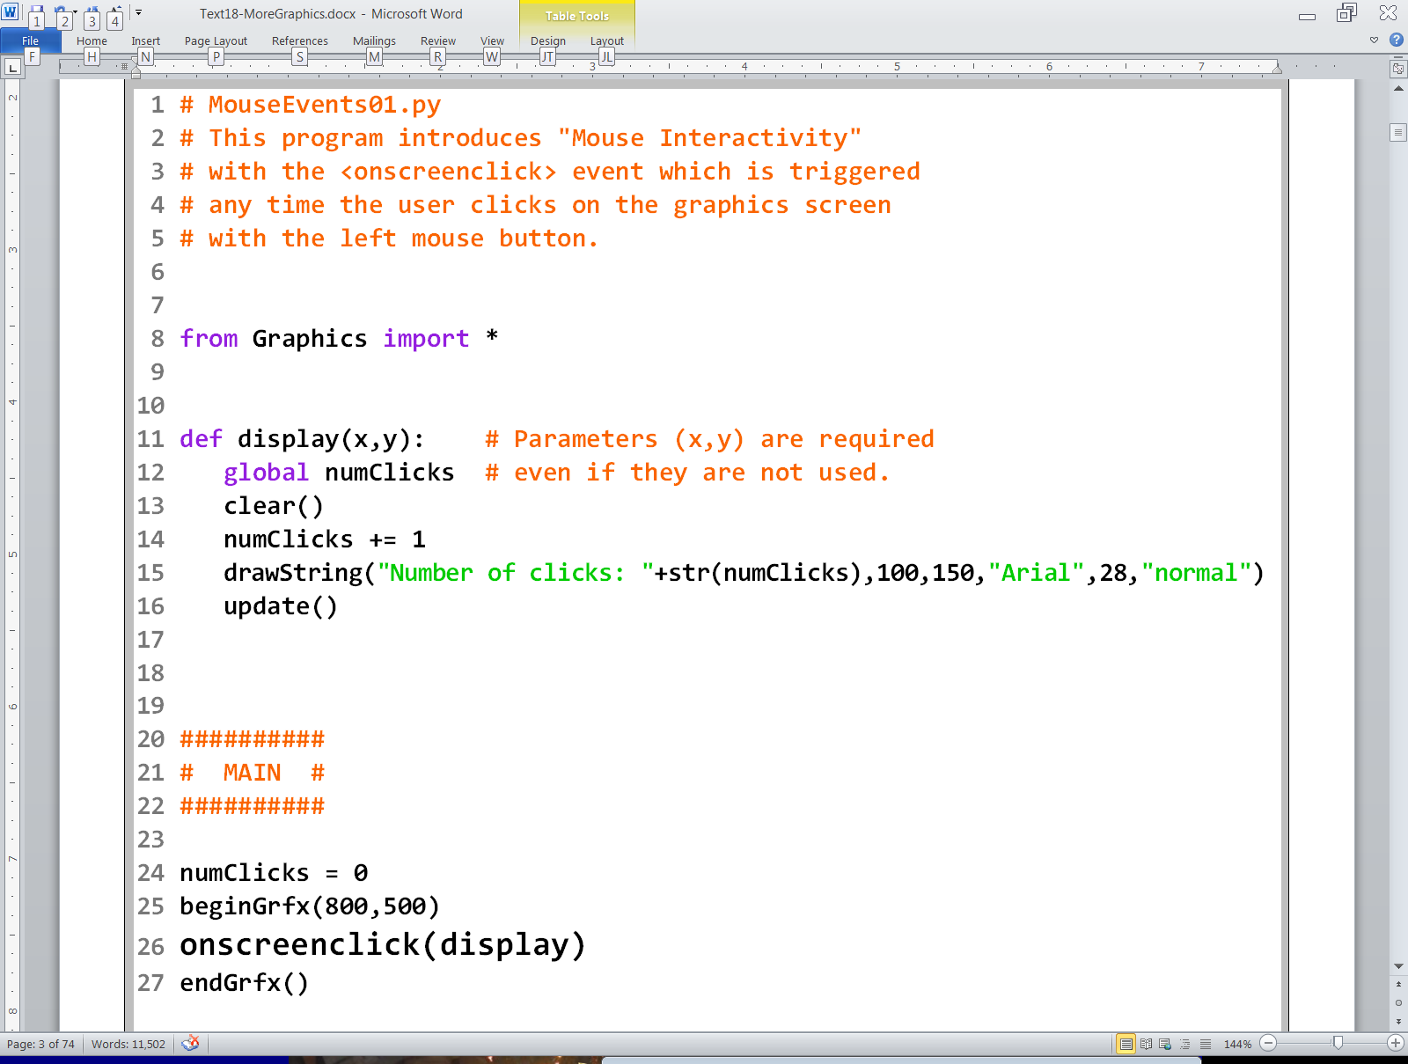

Slide 6
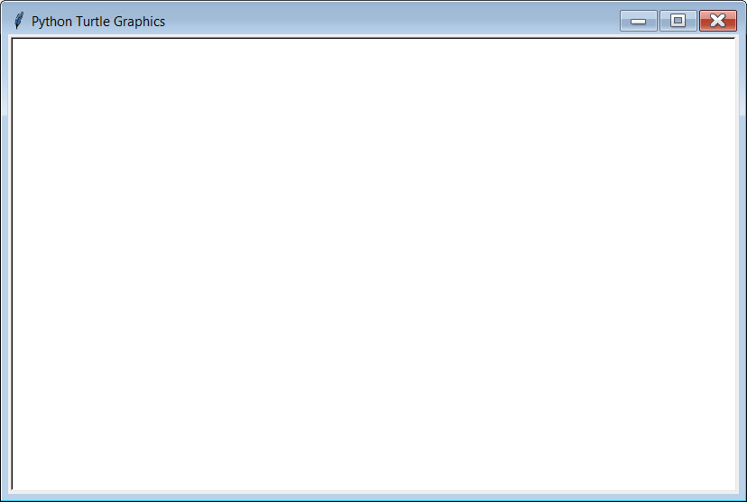
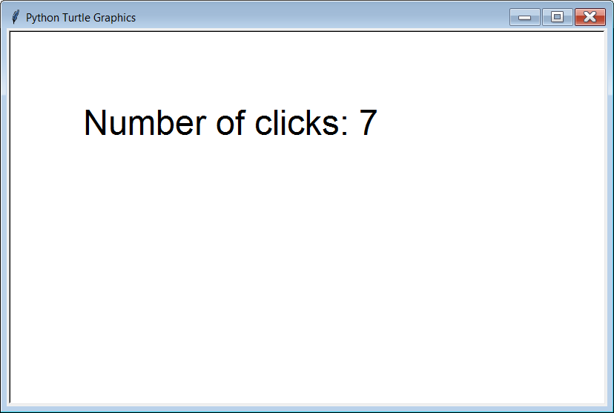
Initial Output
7 clicks later

Slide 7
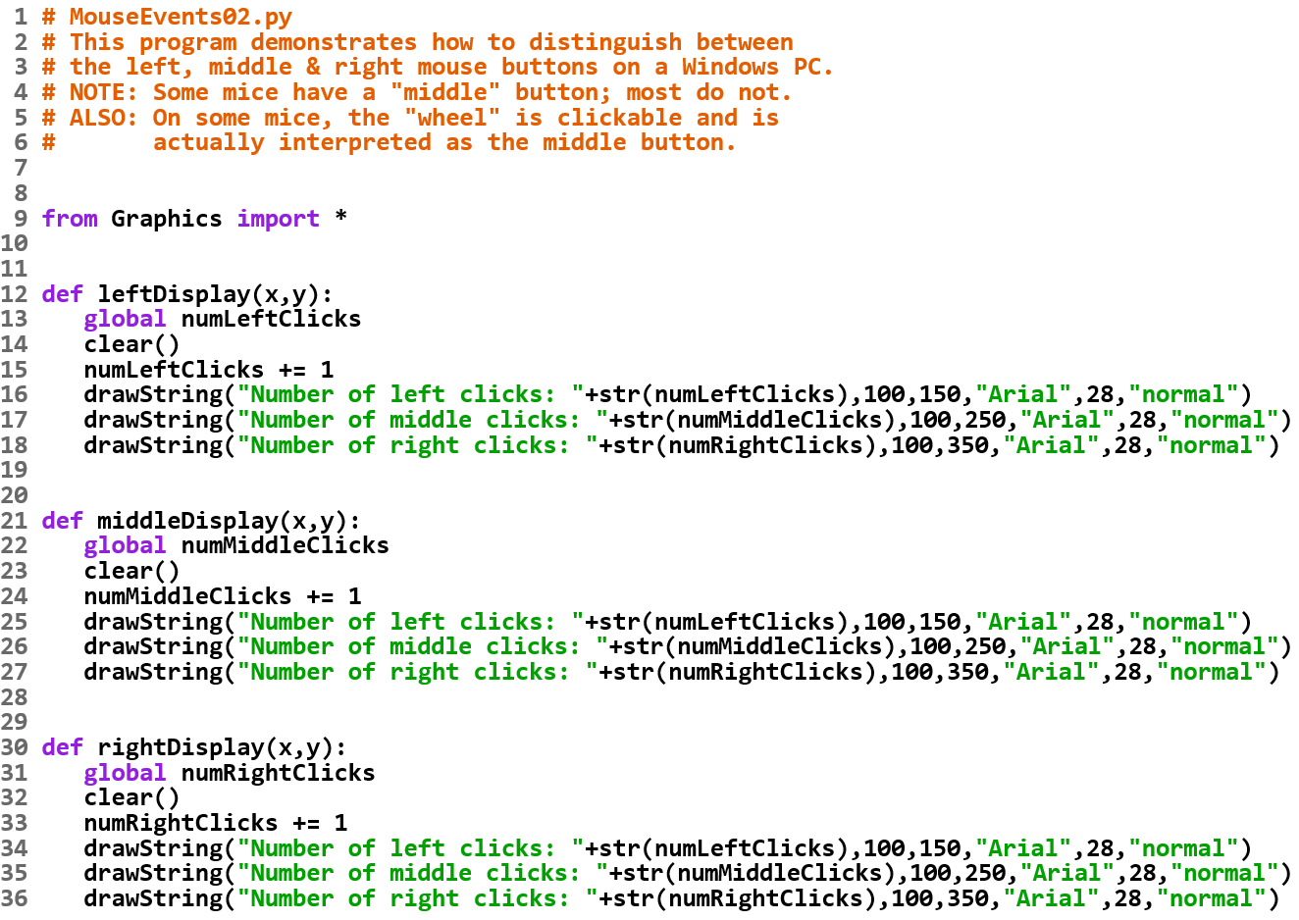

Slide 8
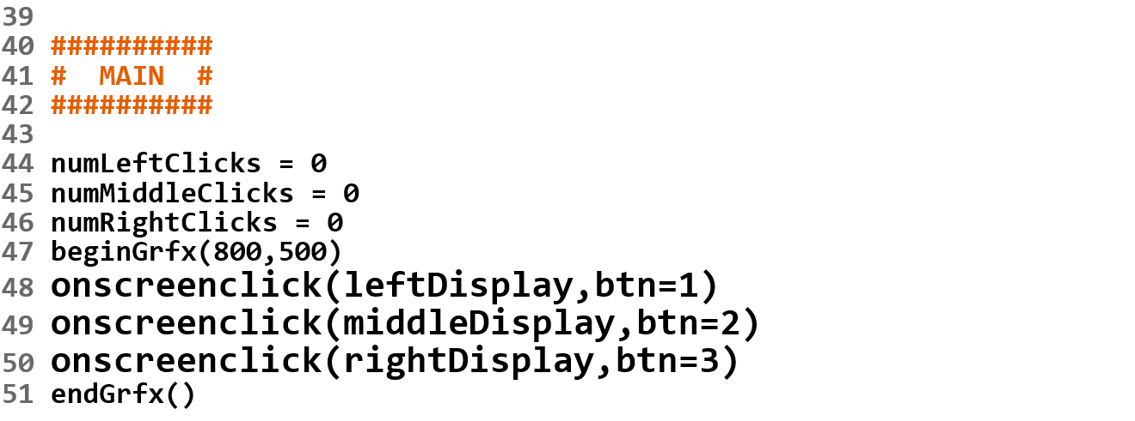
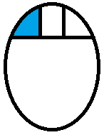
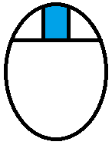
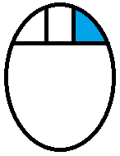
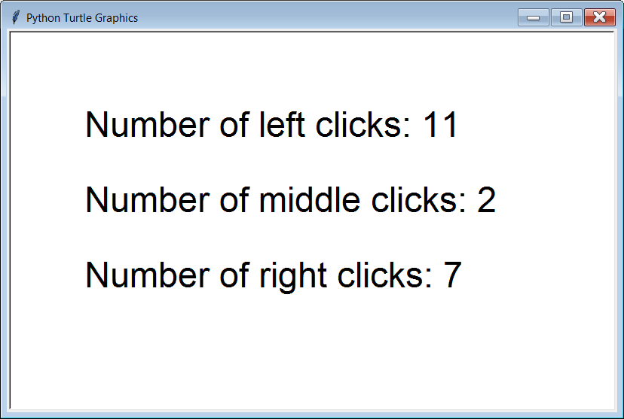
NOTE: On some mice the wheel is clickable and acts as the middle button.
Initial Output

Slide 9
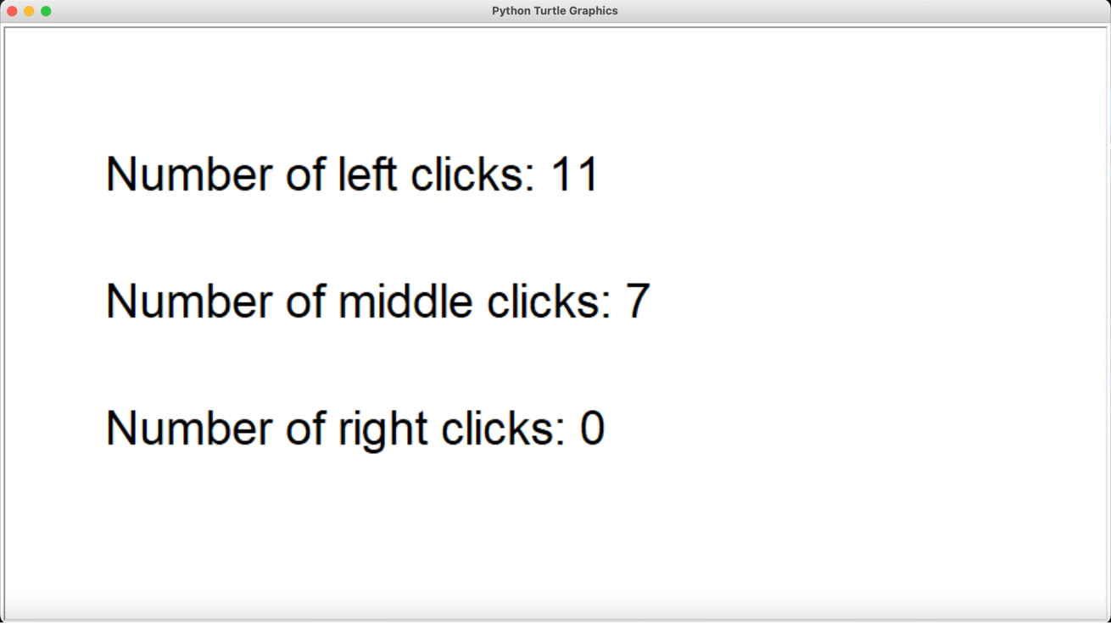
ALSO: If you run this program on a Mac, and right/2-finger click 7 times, you get this output. Since Macs don’t have any type of “middle-click” they use a button value of 2 for right/2-finger click.

Slide 10
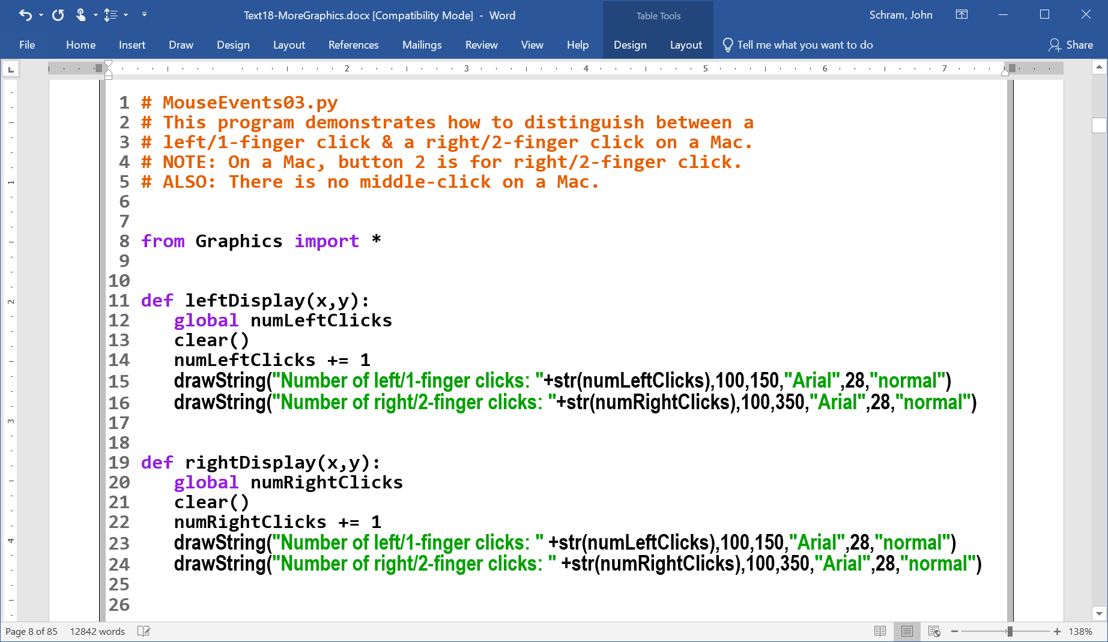

Slide 11
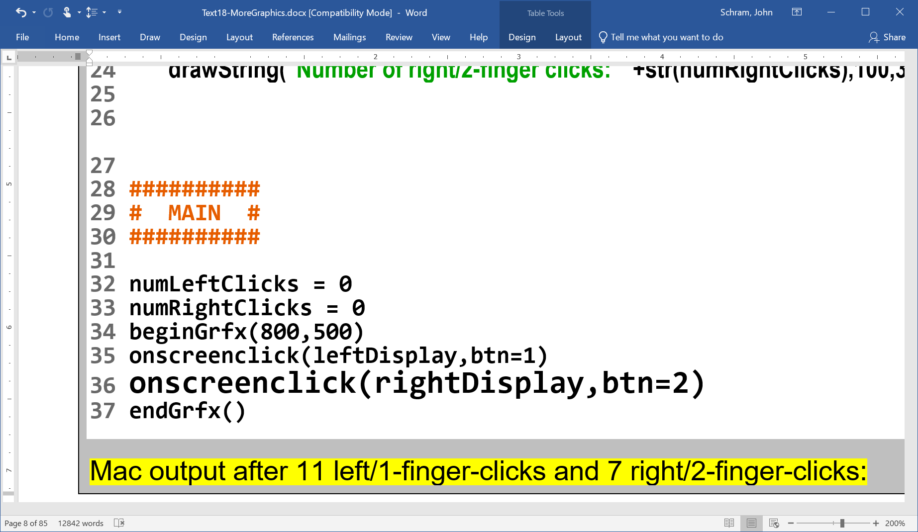
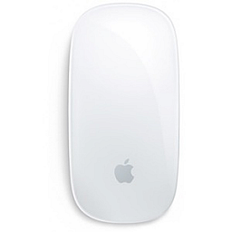
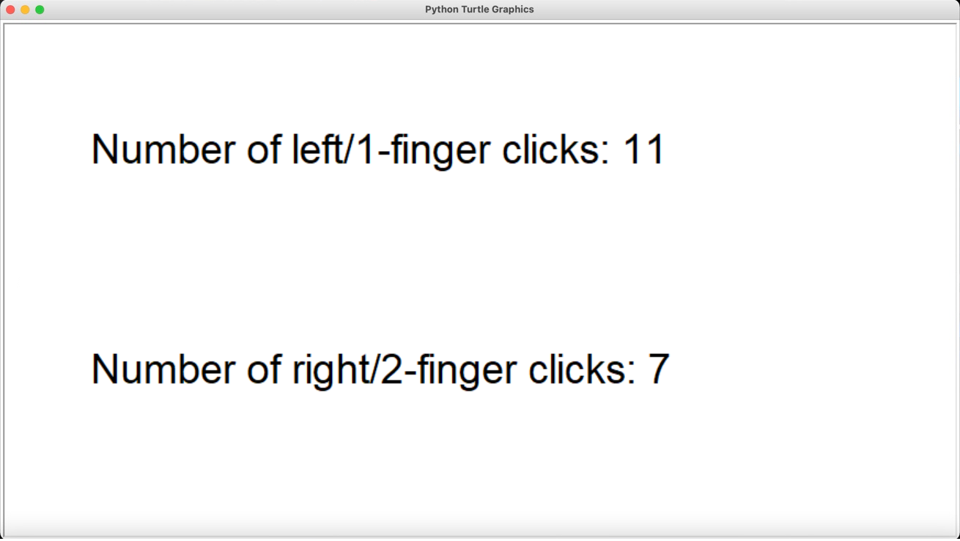

x11 x7
This Photo by Unknown Author is licensed under CC BY-SA

Slide 12
Determining the
Operating System

Slide 13
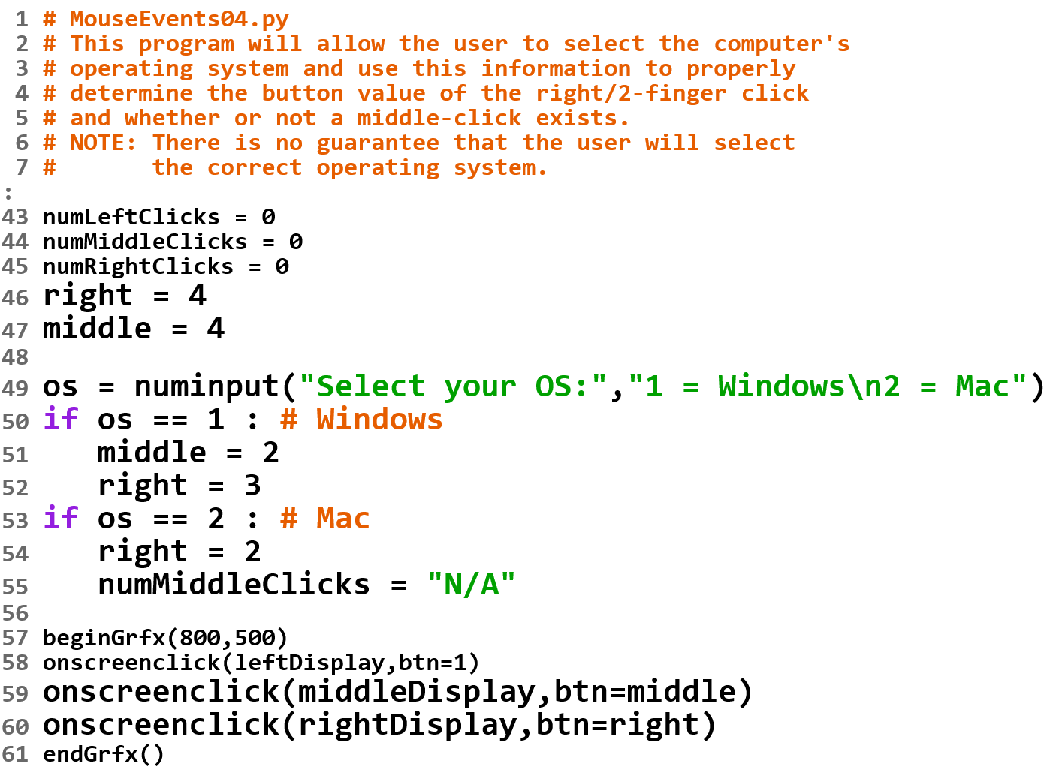

Slide 14
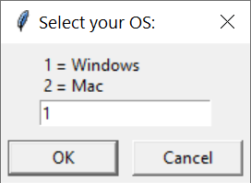

Slide 15
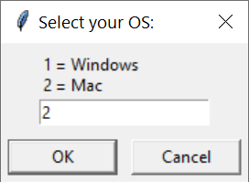
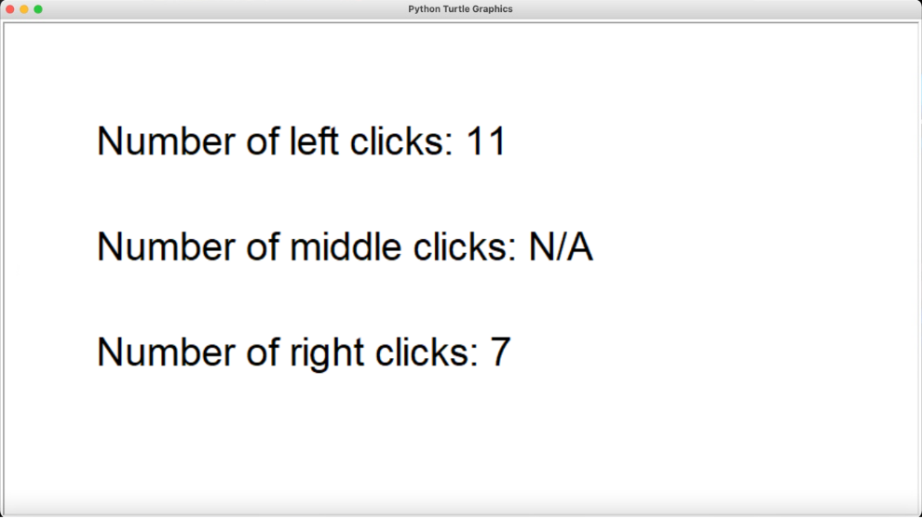

Slide 16
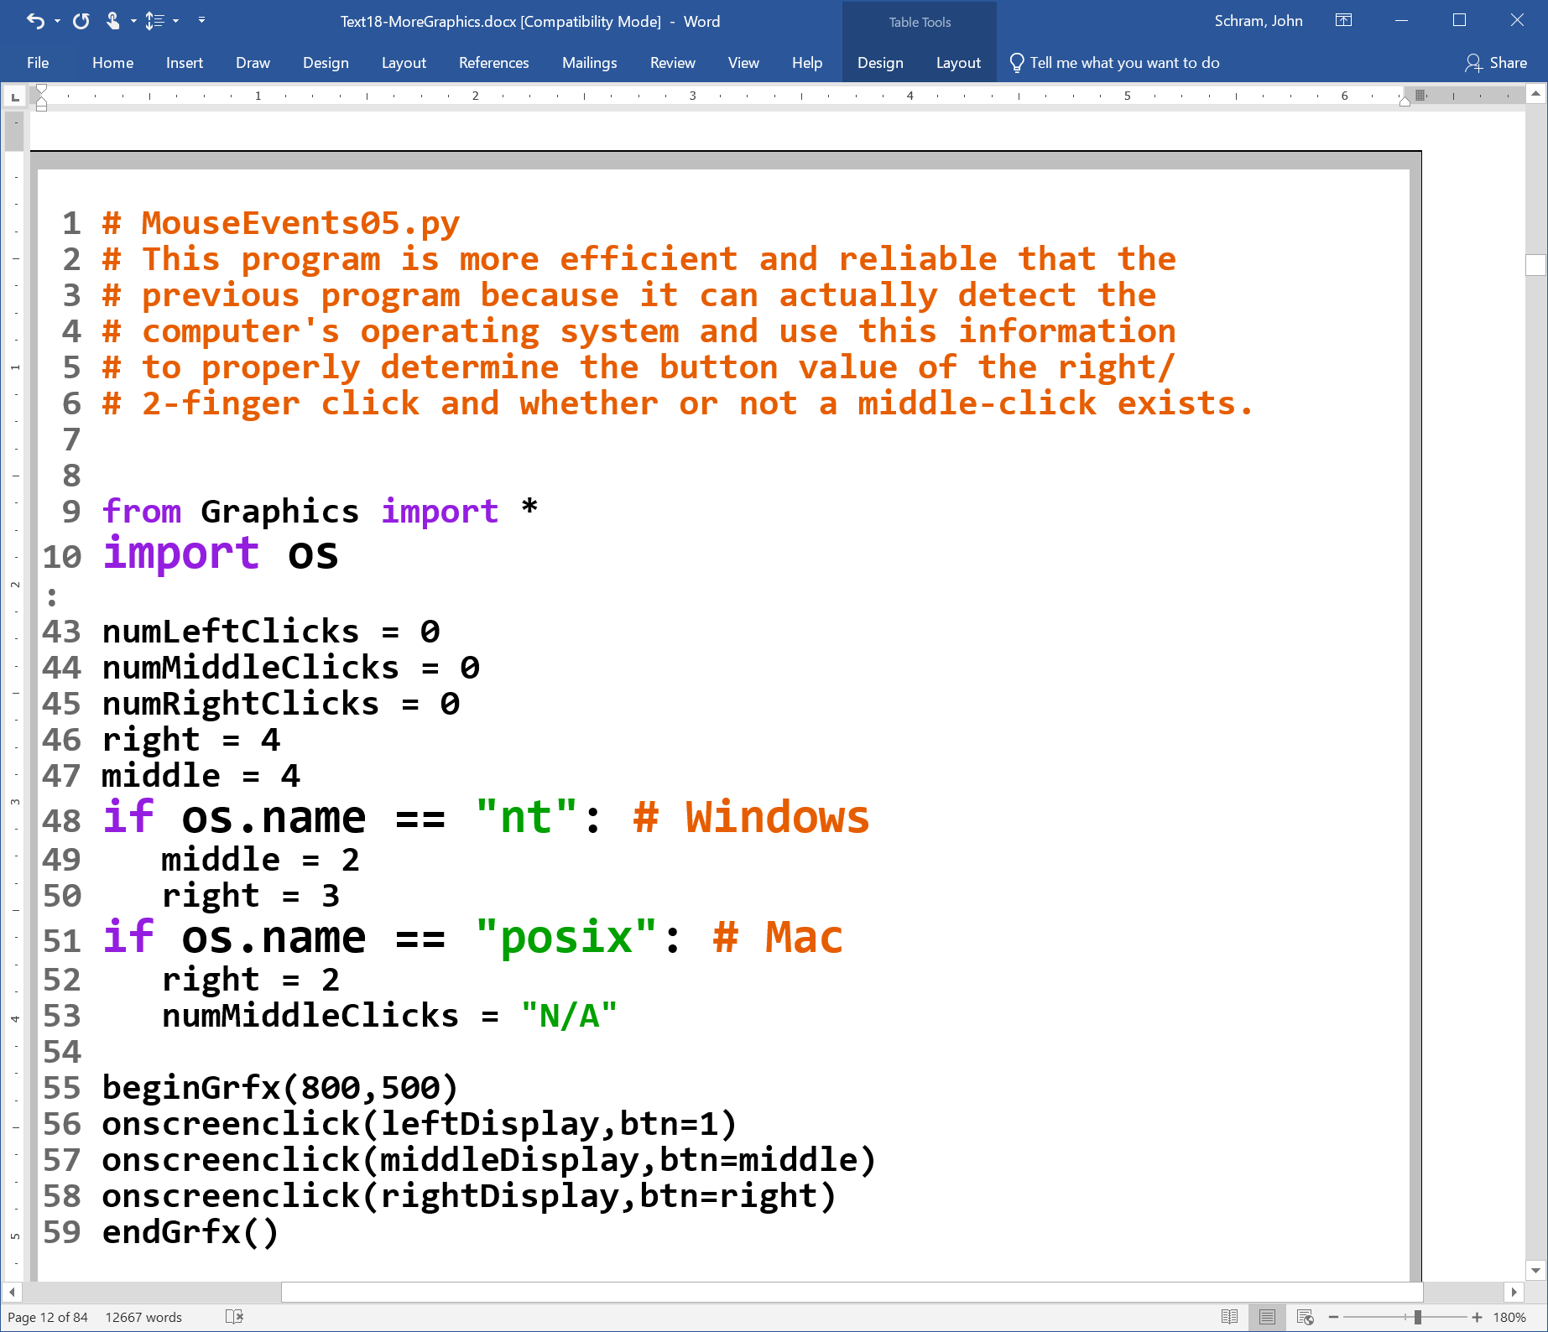

Slide 17
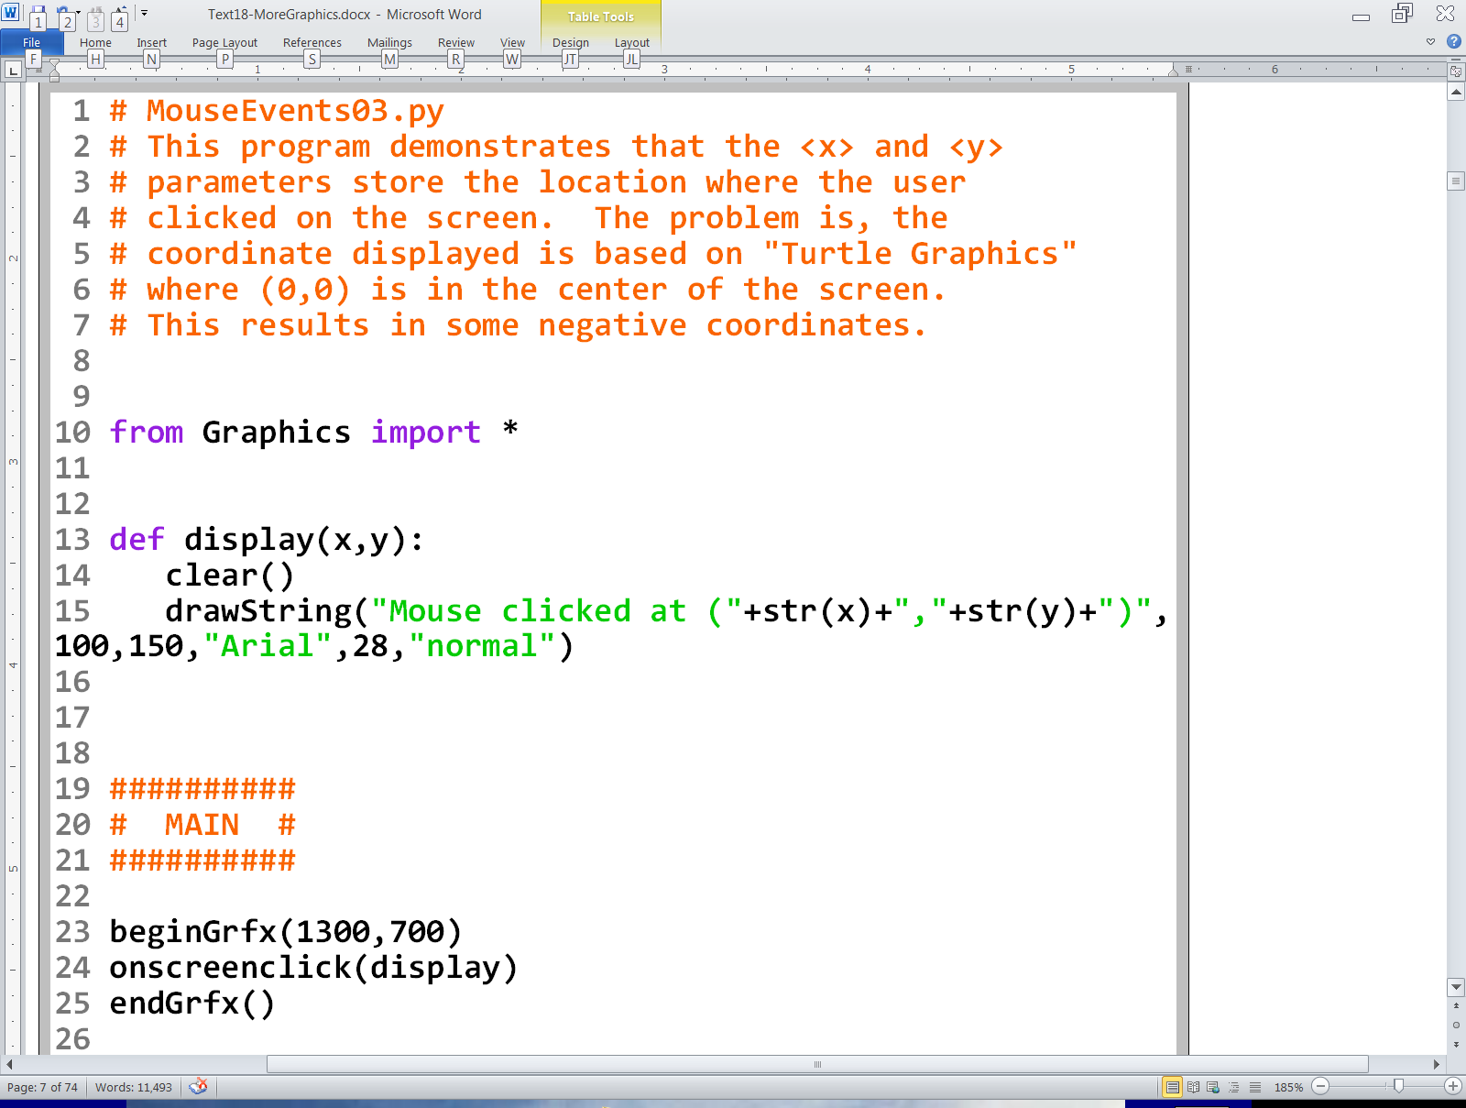
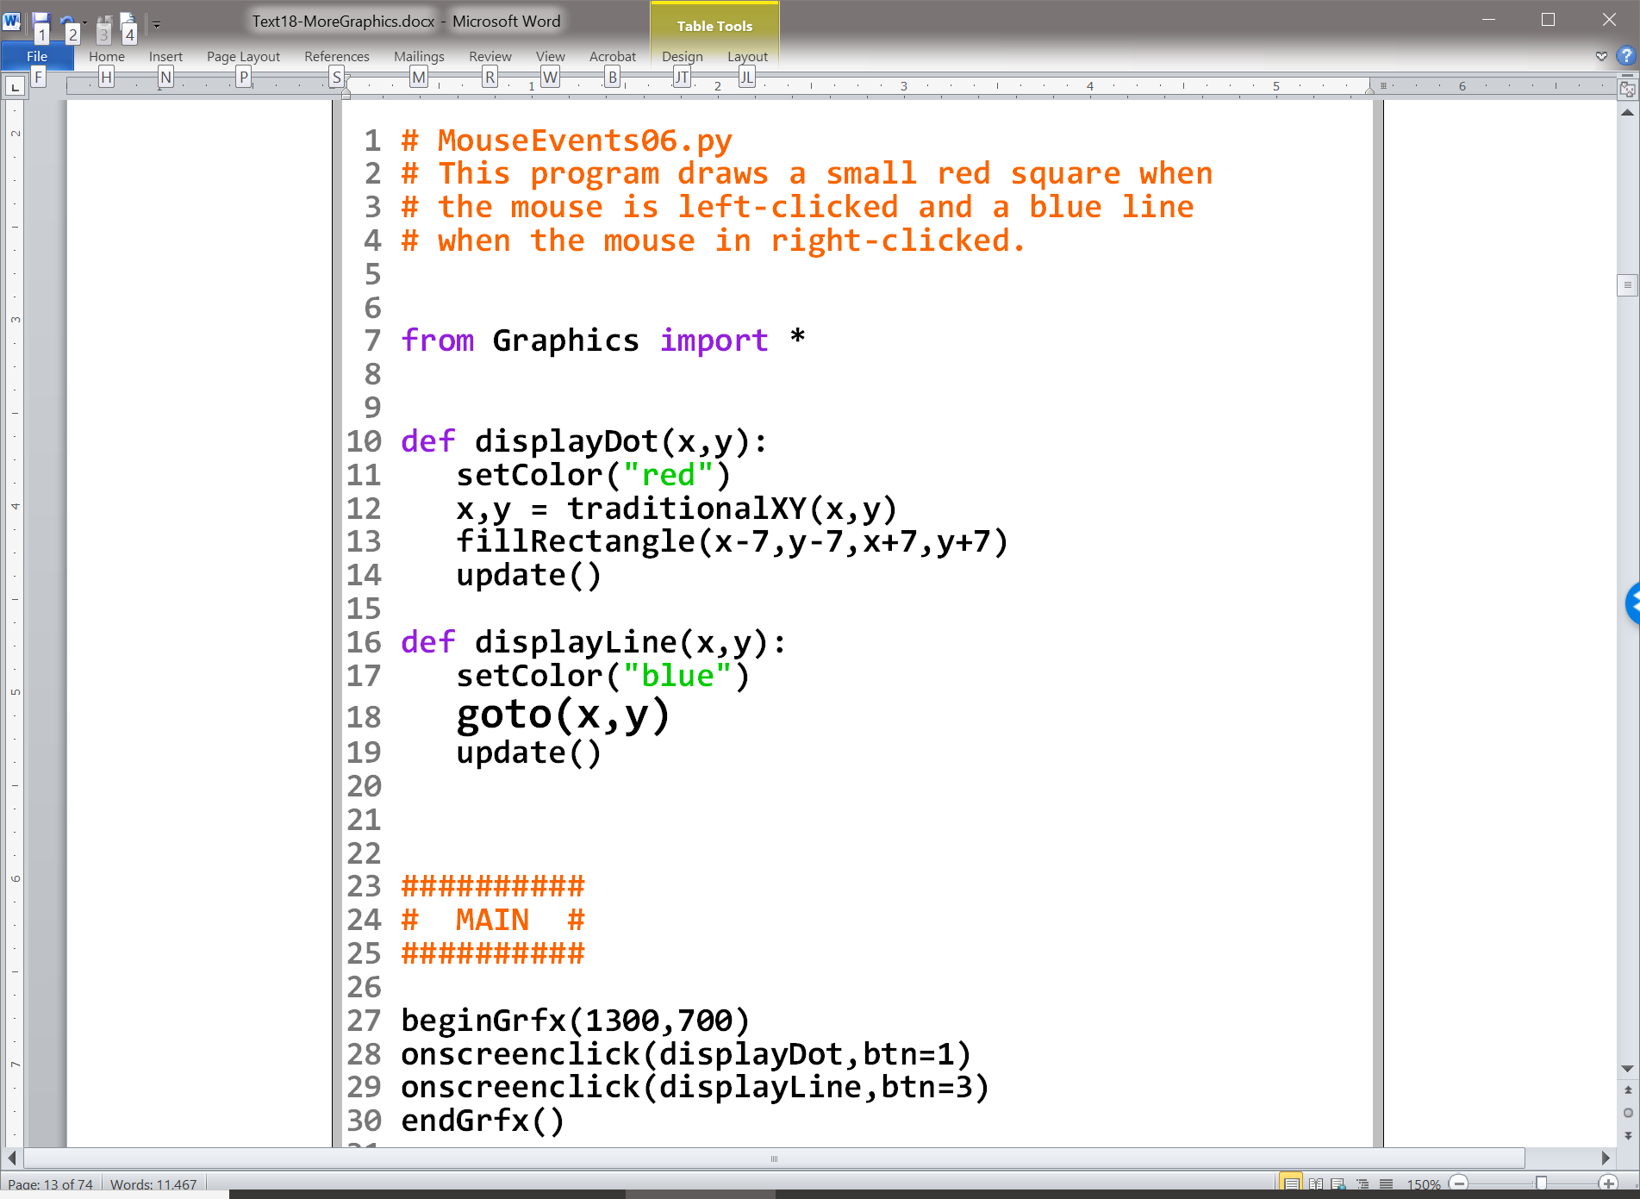

Slide 18
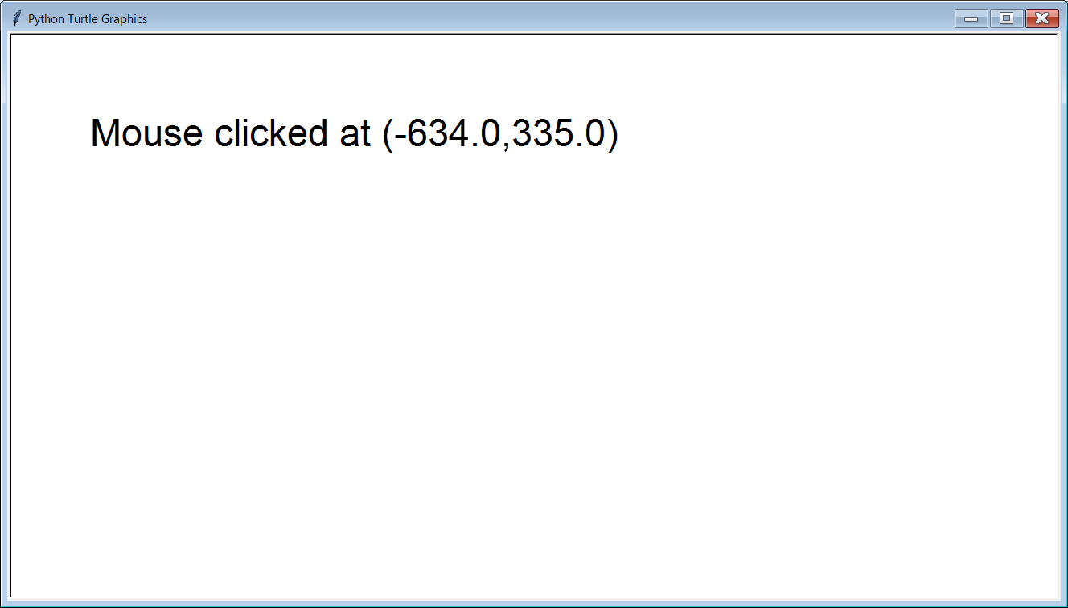
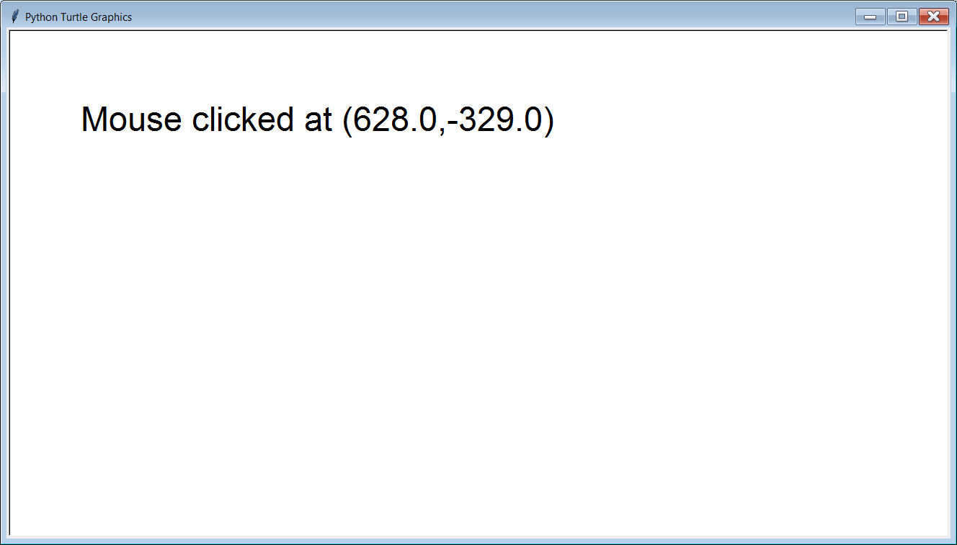

Slide 19




Slide 20
The coordinate returned is based on the coordinate system used by Turtle Graphics where (0,0) is in the center of the window. Any y values below and x values to the left will be negative as the outputs show.

Slide 21
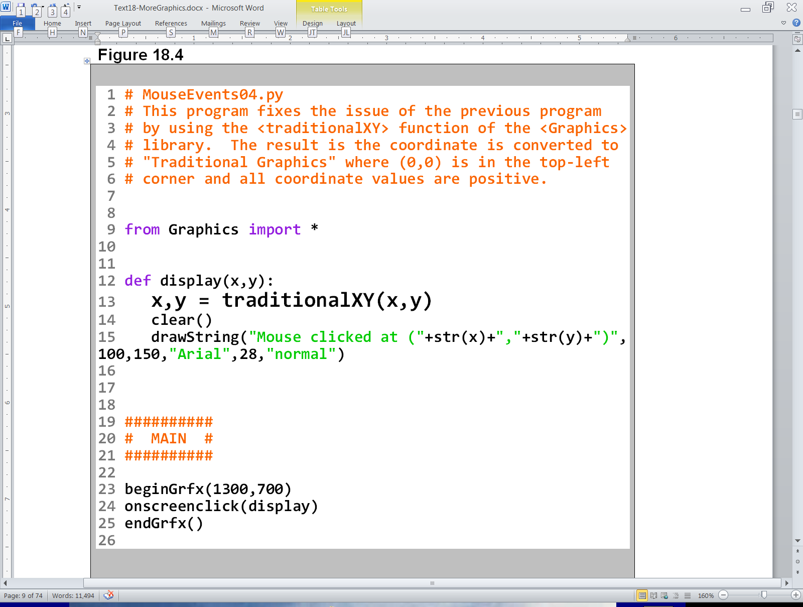
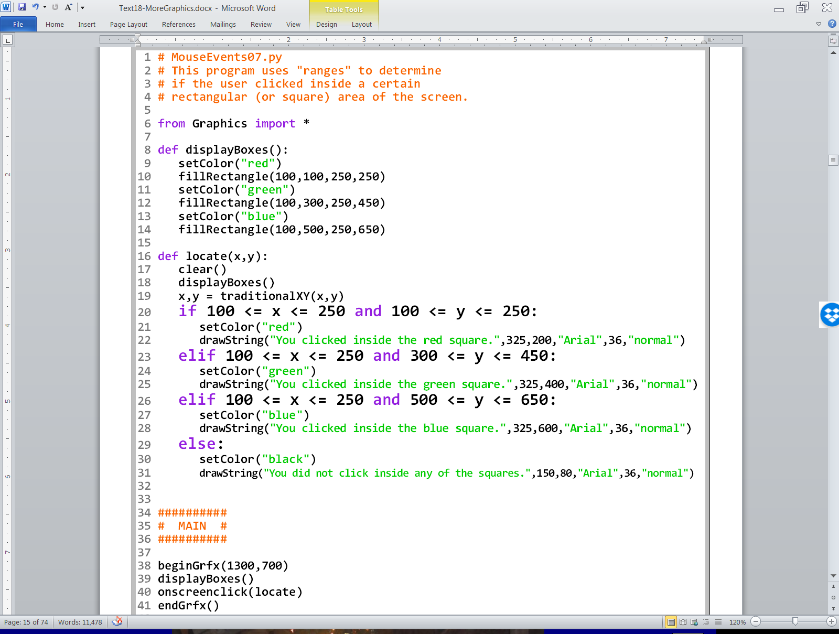

Slide 22
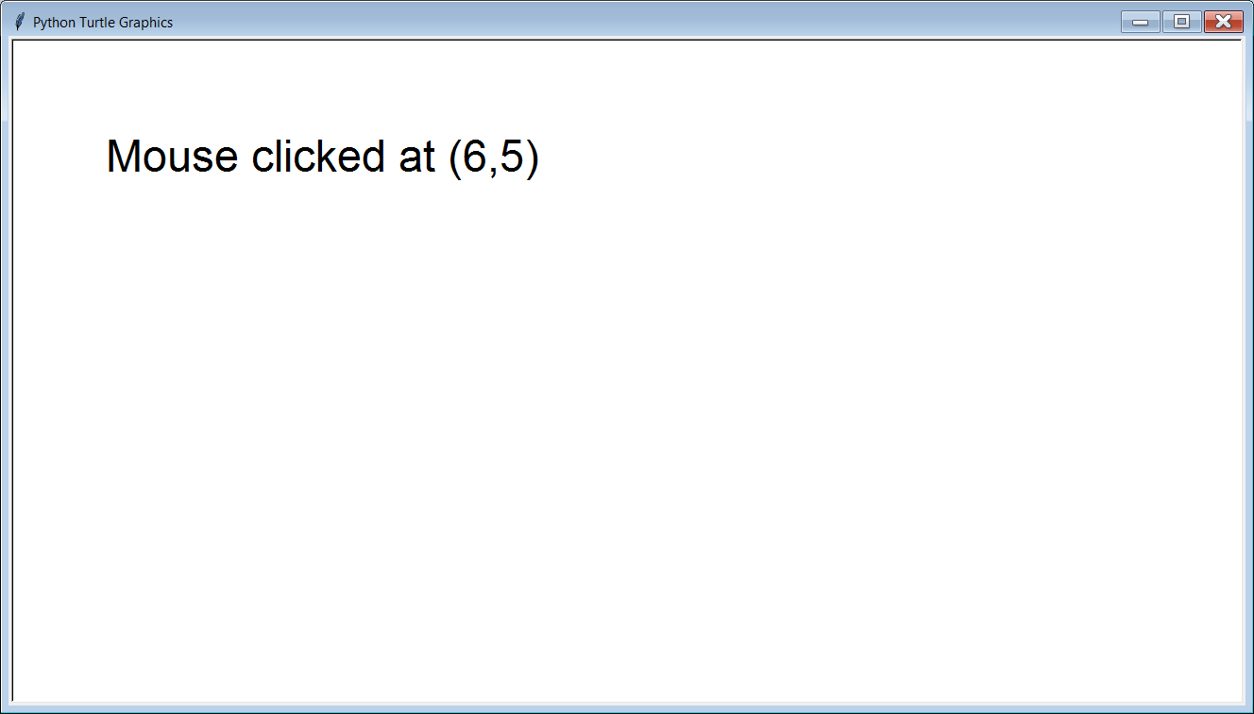
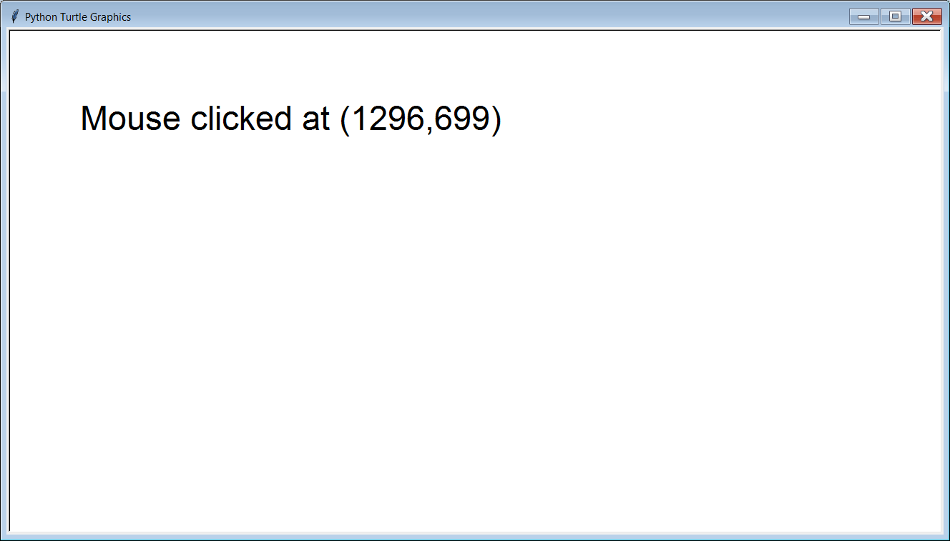

Slide 23
Section 18.3
Creating Simple
Paint Program Tools

Slide 24
Paint Program Tools vs. Entire Paint Program
We are not creating an entire paint program.
That assignment will have to wait for the Advanced Graphics class.
In this class, we are merely introducing some concepts by creating some of the simpler tools from a paint program.
This will lead into Lab 18A.

Slide 25
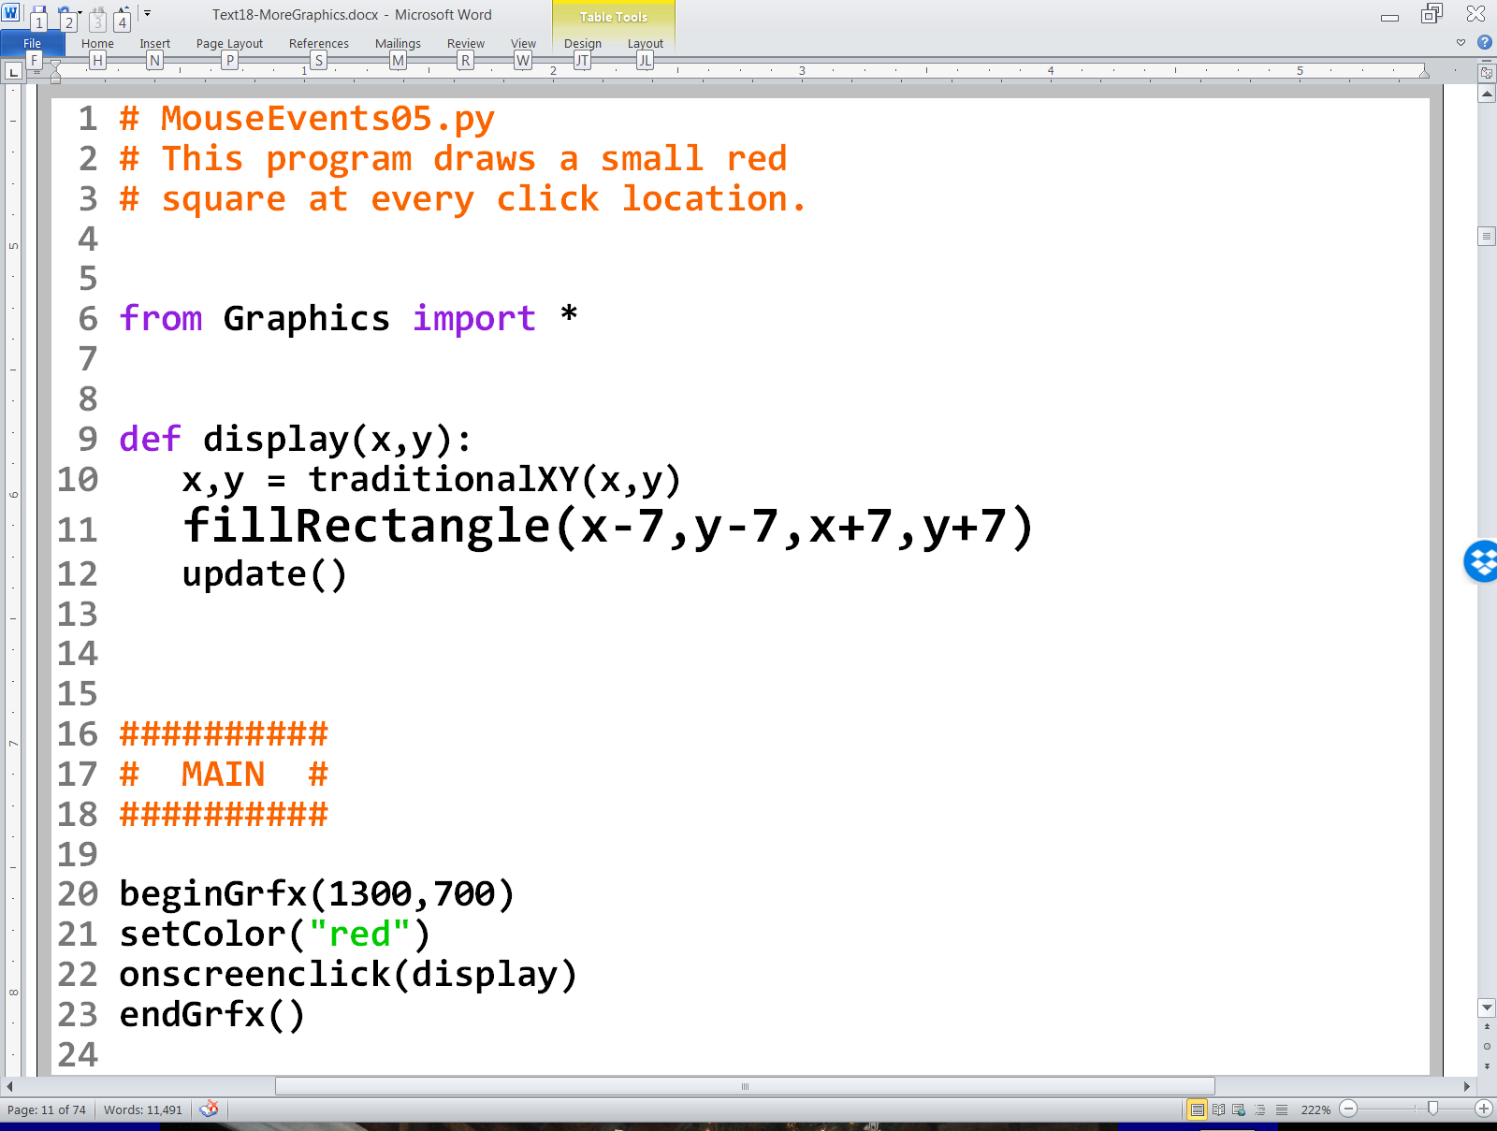
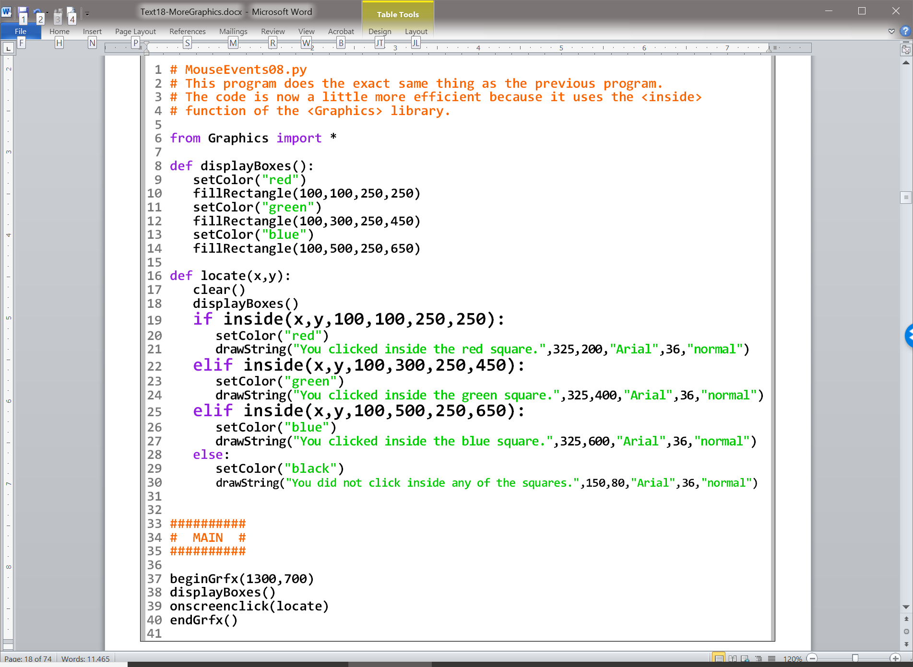
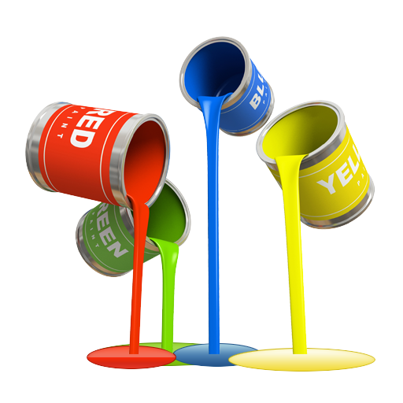

Slide 26
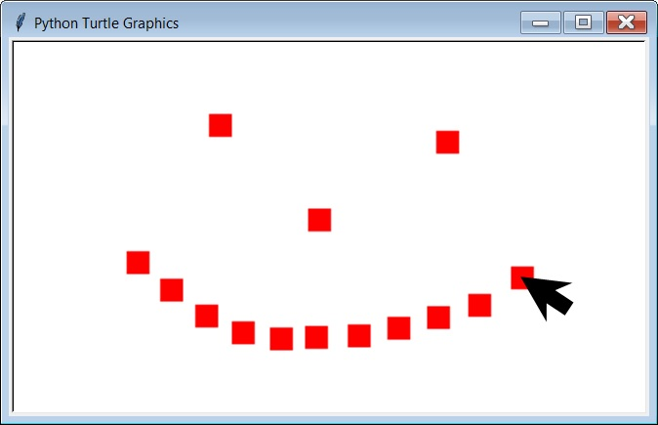

Slide 27
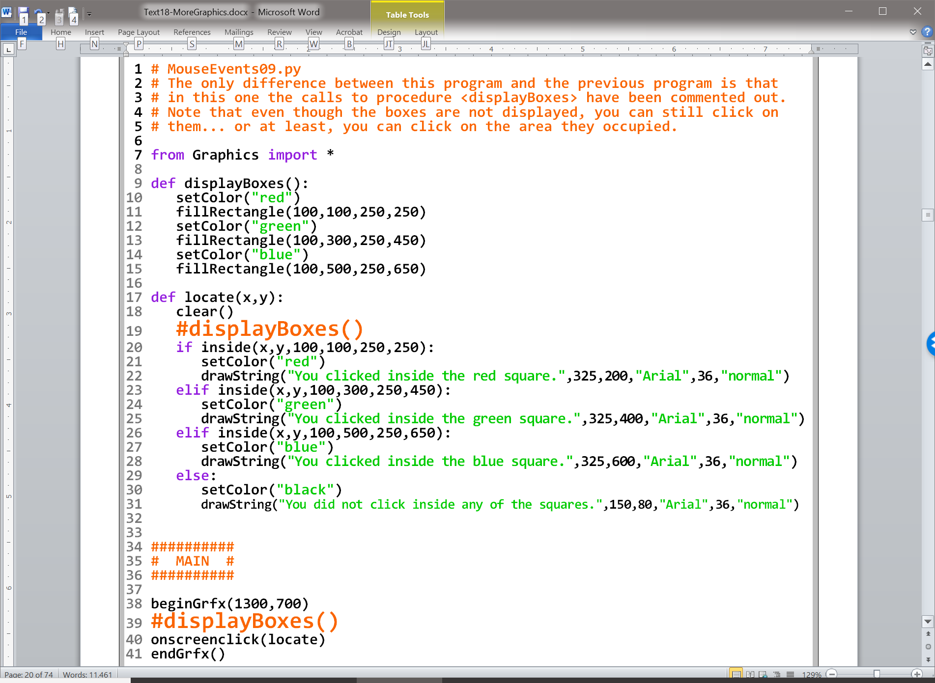

Slide 28
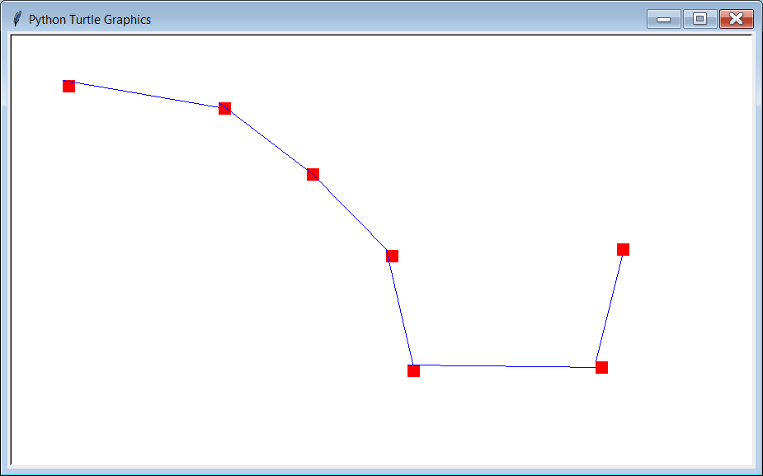

Slide 29
Unlike drawLine, with goto, you only specify the end point. The start point is simply the last coordinate that was used. If the program has just started, the start point is (0,0). Also, goto uses the coordinates from Turtle Graphics, so no conversion is necessary.

Slide 30
Section 18.4
Creating
Clickable Areas

Slide 31
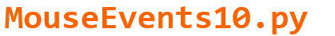

Slide 32
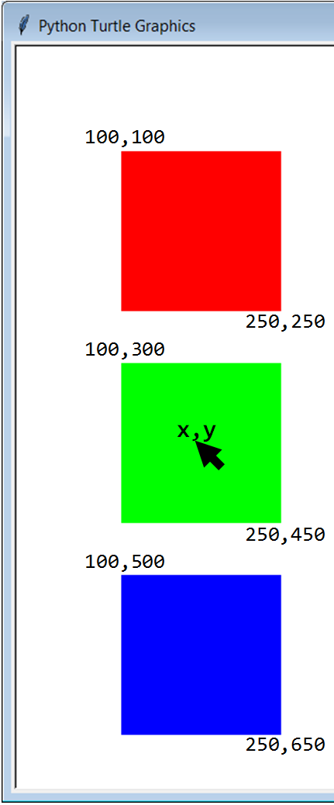

Slide 33
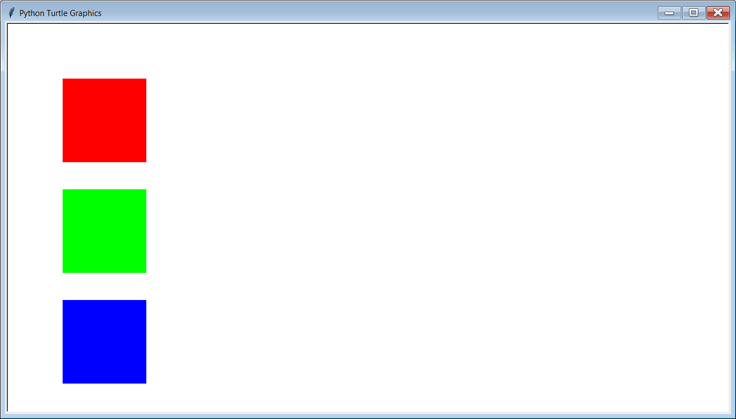
Initial Output

Slide 34
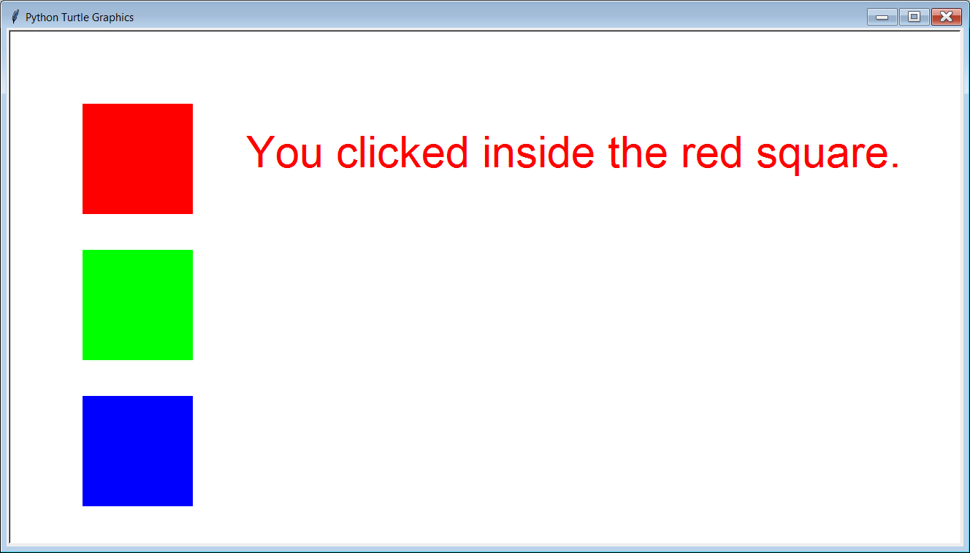

Slide 35


Slide 36
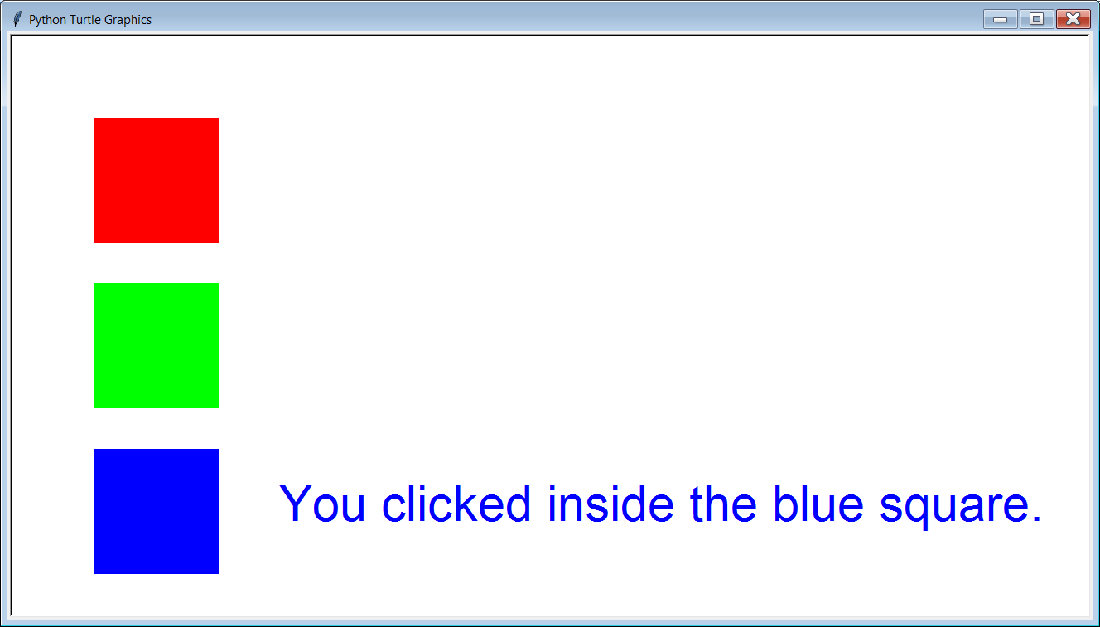

Slide 37
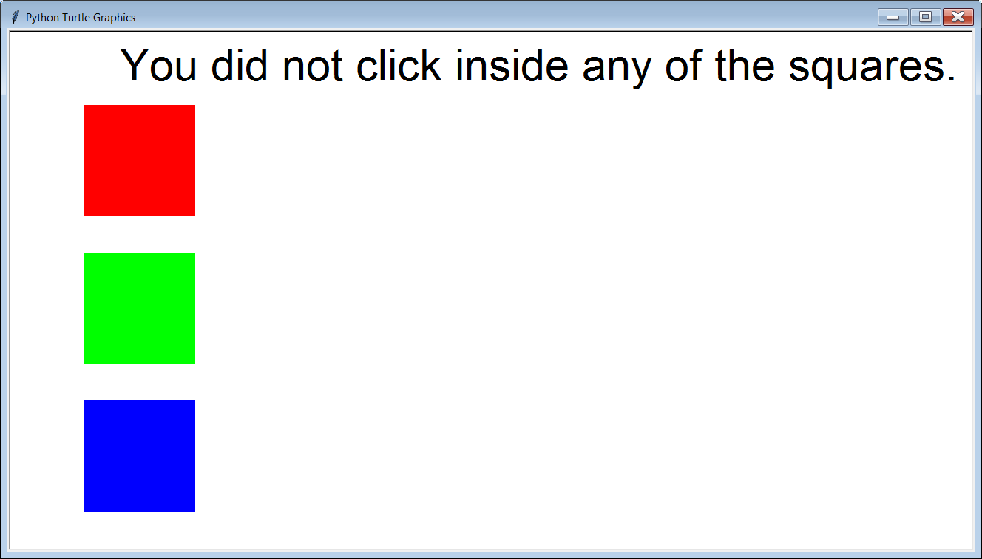

Slide 38
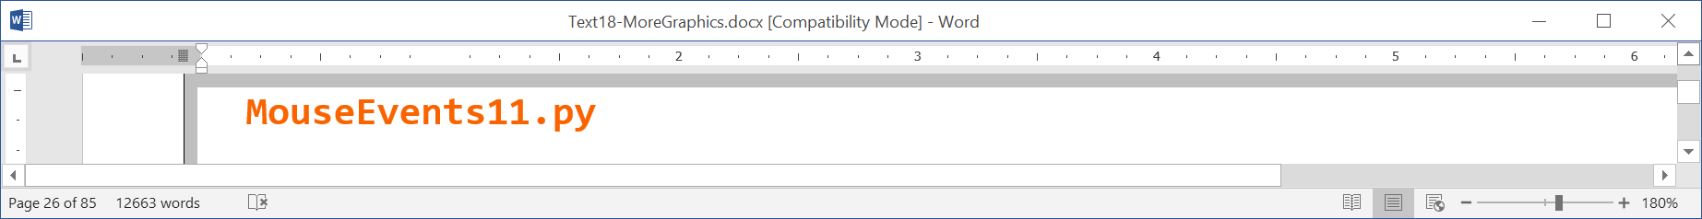

Slide 39
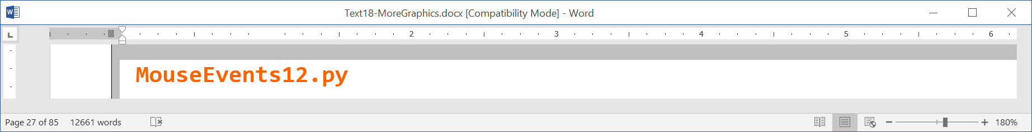

Slide 40
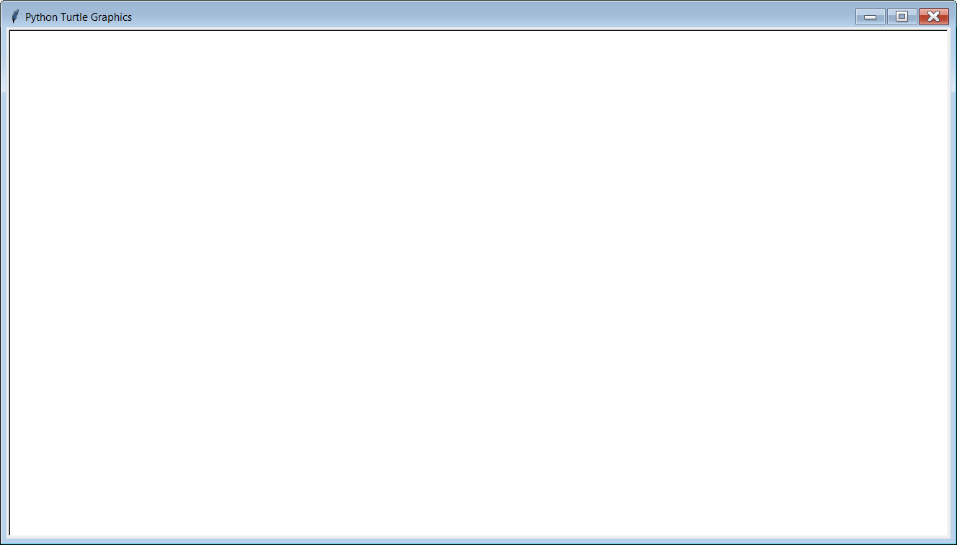
Initial Output

Slide 41
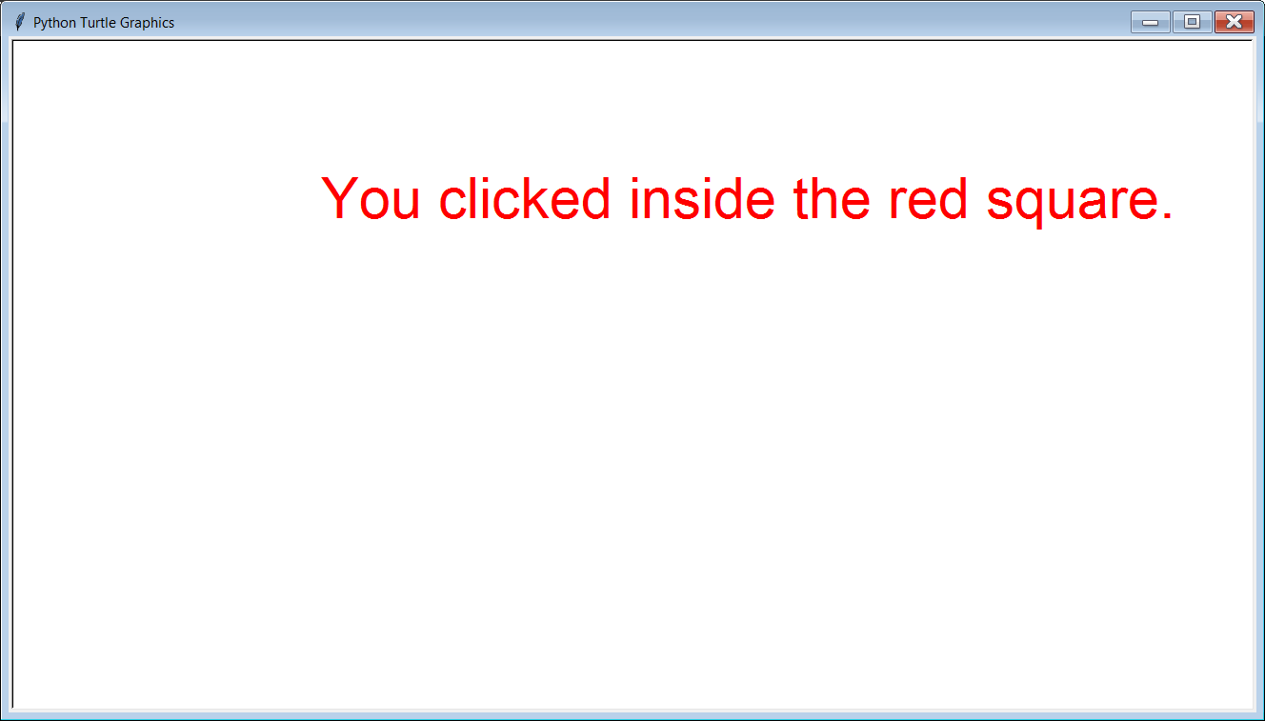

Slide 42
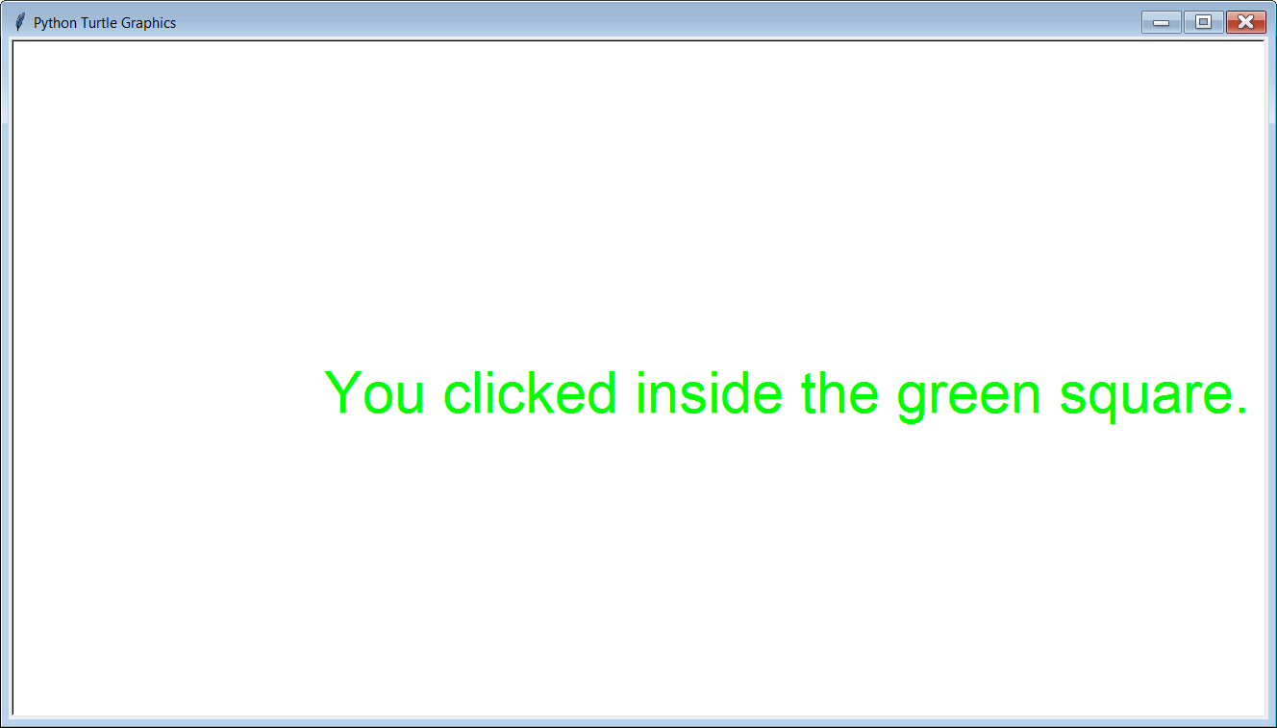

Slide 43
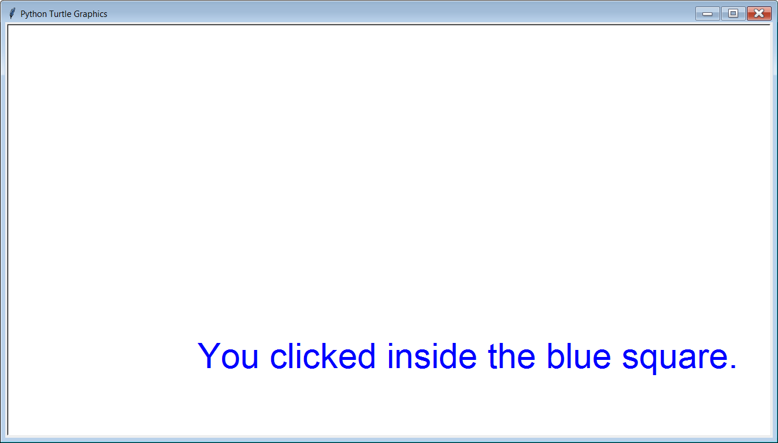

Slide 44
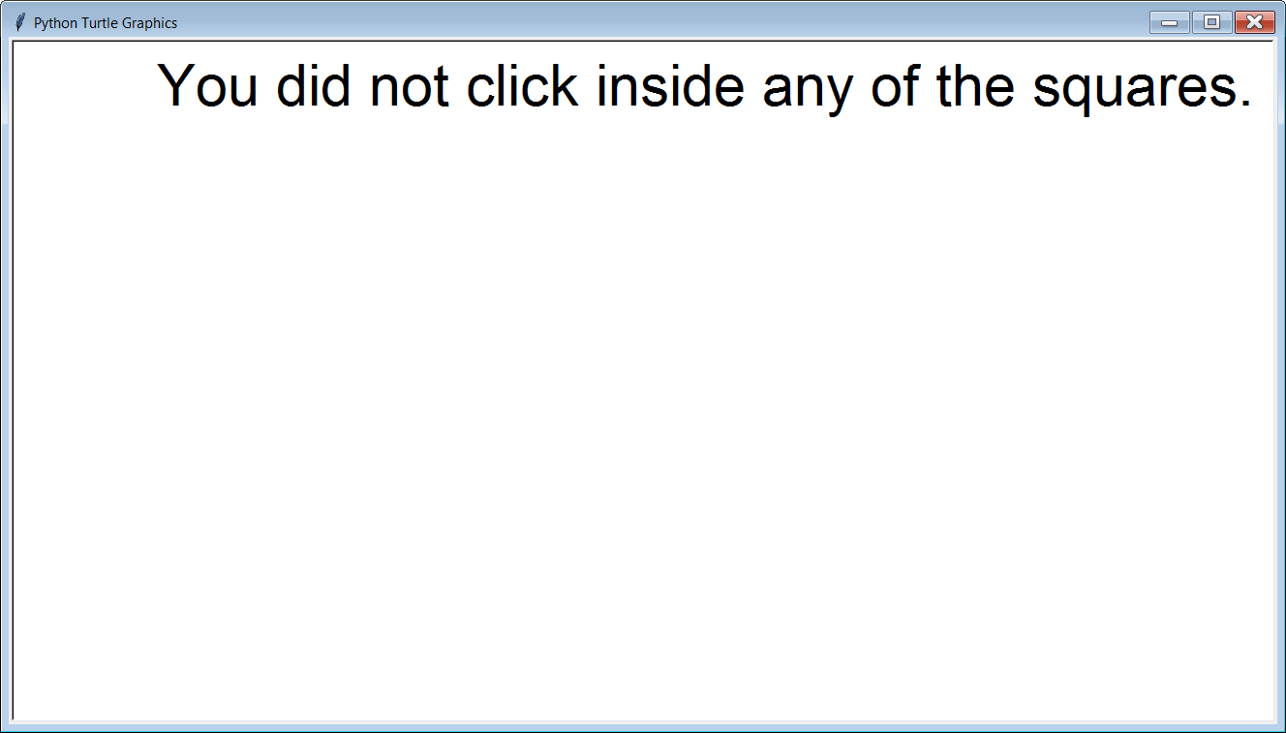

Slide 45

Section 18.5
Key
Events

Slide 46
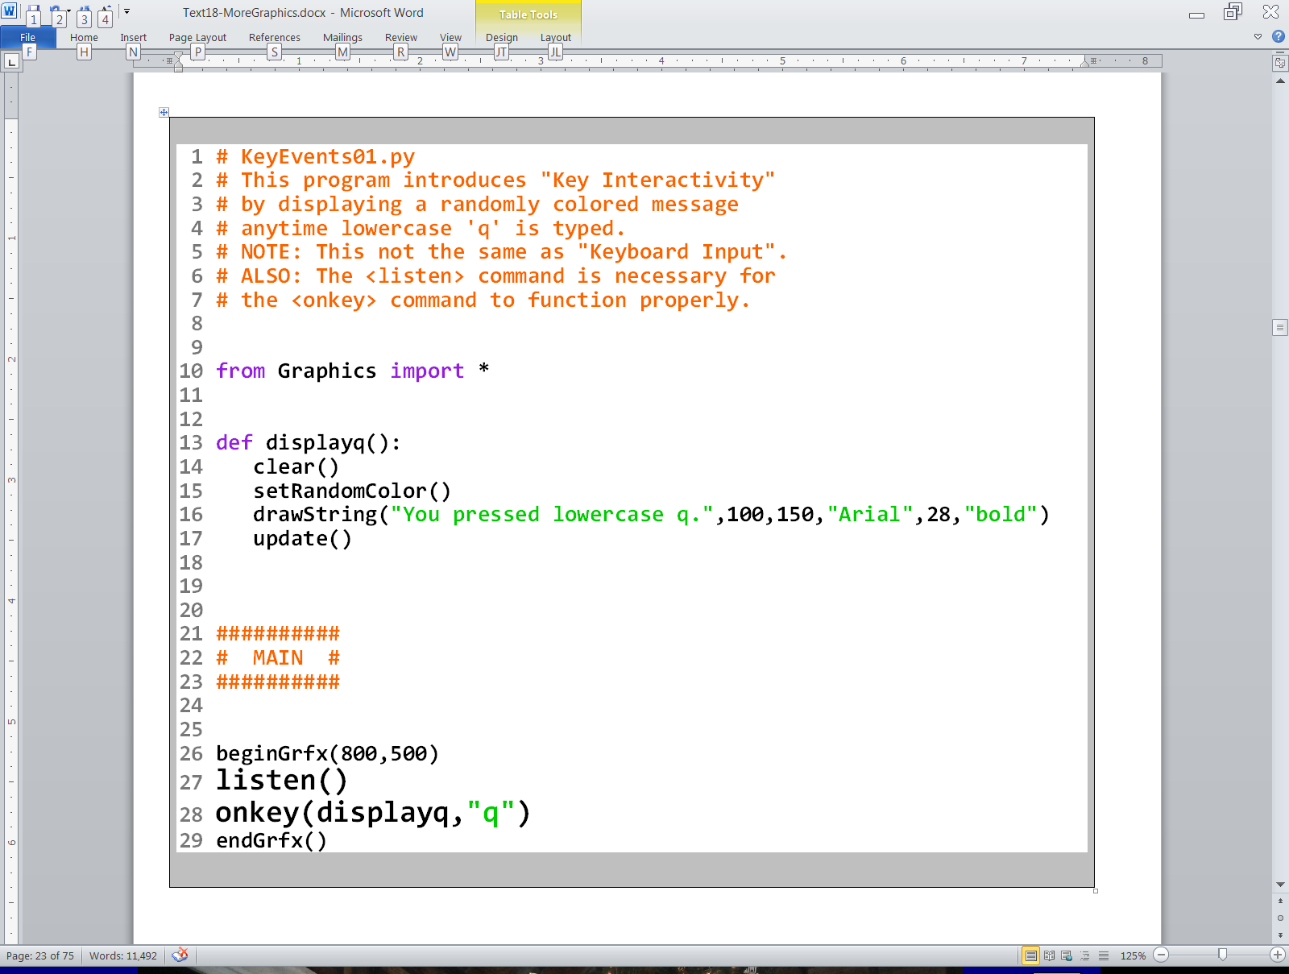

Slide 47
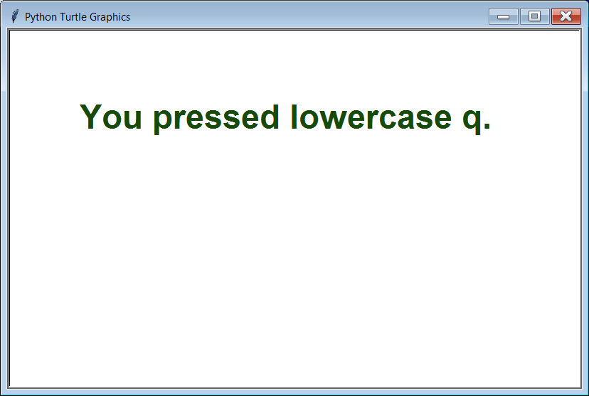

Slide 48


Slide 50


Slide 51




Slide 52


Slide 53




Slide 54


Slide 55


Slide 56


Slide 57


Slide 58


Slide 59


Slide 60

Output after
ANY key is pressed

Slide 61

Output after the
<space bar> is pressed

